Slide 1
Flinkit
By: Sneha vaghela

Slide 2
Objectives
Flinkit
Enhance User Connectivity
Improve Platform Usability
Ensure Data Security and Privacy
Drive User Growth and Retention
Integrate Scalable Technologies
Generate Sustainable Revenue Streams
Foster a Collaborative Ecosystem
Flinkit
Flinkit

Slide 3
Problem Statement
Flinkit
In today’s increasingly digital and interconnected world, individuals and organizations face significant challenges in managing and streamlining their online interactions, content sharing, and professional networking across multiple platforms. Existing solutions are often fragmented, lack user-centric design, and fail to offer seamless integration between communication, collaboration, and content management tools.
This disjointed experience results in lost productivity, poor user engagement, data silos, and security concerns. Users demand a smarter, more unified platform that simplifies their digital lives while enhancing meaningful connections, efficient information sharing, and secure data management.
Filink aims to address this gap by creating an integrated, user-friendly platform that centralizes digital connectivity, enables secure and dynamic link sharing, and fosters collaboration in both personal and professional spher
Flinkit
Flinkit

Slide 4
Approach
A comprehensive Search Engine Optimization (SEO) strategy for Flinkit can help the platform improve its organic visibility, drive more traffic, and increase conversions. Here's an approach to SEO tailored to Flinkit's business model, focusing on both technical and content aspects
1.Keyword Research & Optimization
SEO Keyword Strategy
Optimized Keyword Planning
Targeted Keyword Research
Keyword Optimization Tactics
2.On-Page SEO Optimization
Content SEO Tweaks
On-Site SEO Fixes
Page-Level Optimization
Flinkit
Flinkit
Flinkit

Slide 5
SEO Content Boost
HTML SEO Enhancements
3. Content Strategy & Blogging
Smart Content Planning
Blog Growth Strategy
Content Marketing Blueprint
Strategic Blogging Approach
Engaging Content Plan
4. Technical SEO
Site SEO Audit
Backend SEO Fixes
Technical Site Optimization
SEO Performance Boost
Flinkit
Flinkit
Flinkit

Slide 6
6. Local SEO Strategy
Local Search Boost
Nearby SEO Tactics
Geo-Targeted SEO Plan
Local Ranking Strategy
Map Pack Optimization
Finkit
Flinkit
Flinkit

Slide 7
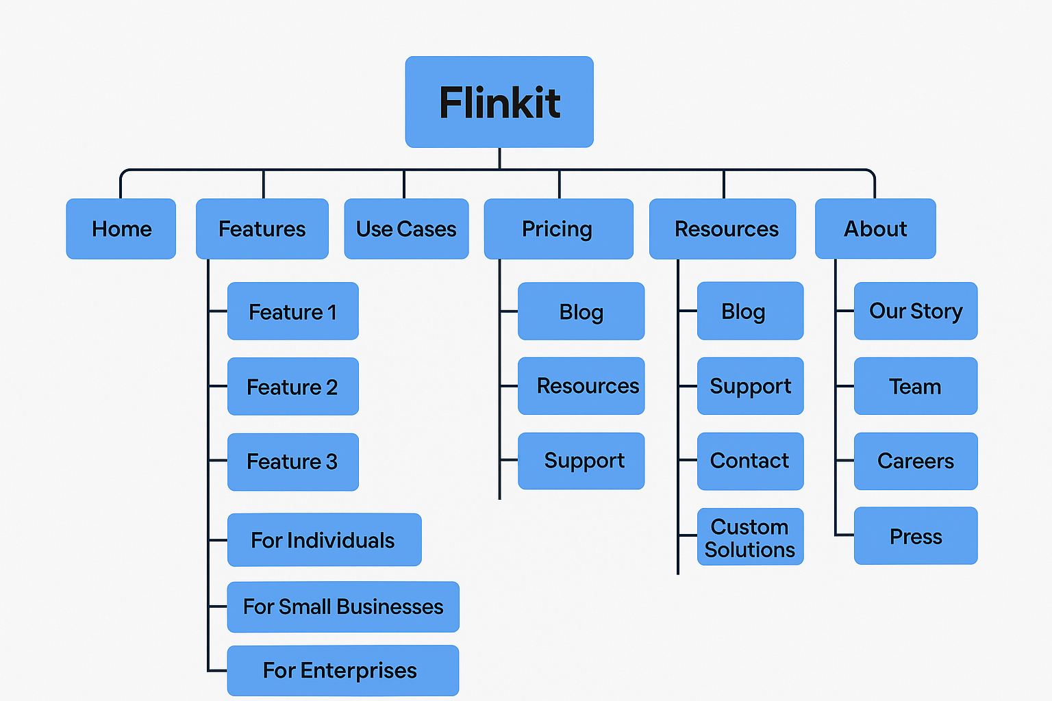
Website Structure
Flinkit
Flinkit
Flinkit

Slide 8
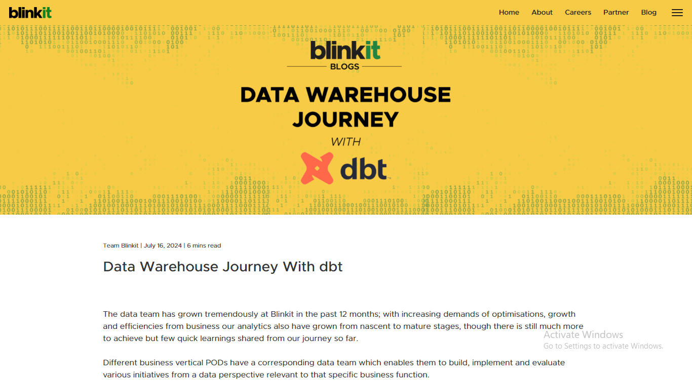
Blog page
Flinkit
Flinkit
Flinkit

Slide 9
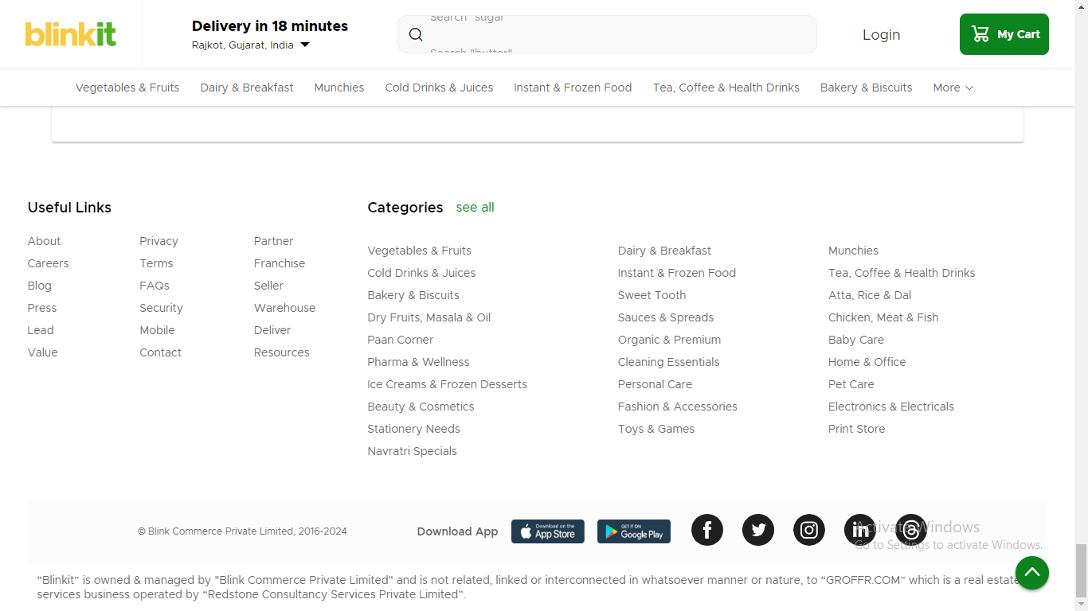
Categories page
Flinkit
Flinkit
Flinkit

Slide 10
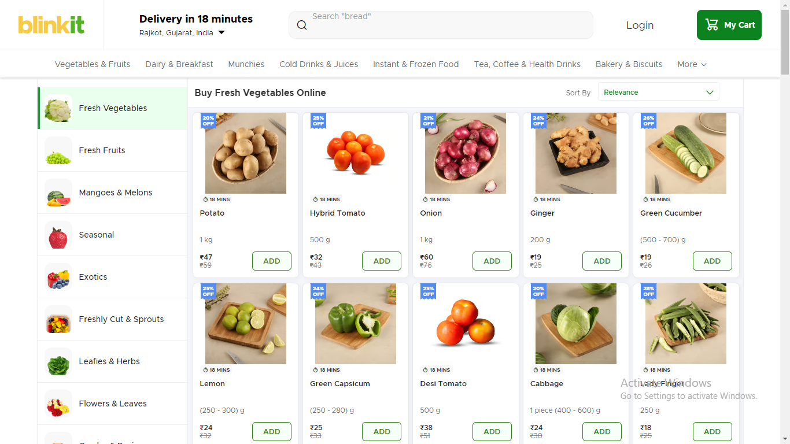
Sub Categories page
Flinkit
Flinkit
Flinkit

Slide 11
Content structure
Flinkit is a fast-commerce platform that focuses on delivering groceries and essentials to consumers in a quick and efficient manner. The content structure of Flinkit can be broken down into several key components, which are designed to provide a smooth user experience for browsing and ordering products. Here's a breakdown of its typical content structure:
1. Homepage
2. Product Pages
3. Shopping Cart
4. Checkout Flow
5. Account/Profile Page
Flinkit
Flinkit
Flinkit

Slide 12
Competitive Analysis
Flinkit
In the fast-commerce and online grocery delivery sector, Flinkit competes with several well-established and emerging brands. Major competitors include:
BigBasket
Amazon Pantry
JioMart
Dunzo
Zepto
Flipkart Supermart
Flinkit
Flinkit

Slide 13
Keyword Research
Here’s a breakdown of how to approach keyword research for Flinkit, including primary, secondary, long-tail keywords, and focus on local SEO:
Primary Keywords (High-Volume, General)
Online grocery delivery
Grocery delivery near me
Buy groceries online
Quick grocery delivery
Online food delivery
Grocery store delivery
Same-day grocery delivery
Online grocery shopping India
Grocery delivery app
Flinkit
Flinkit
Flinkit

Slide 14
Secondary Keywords (Product-Specific, Related)
Fresh produce delivery
Dairy delivery
Snacks delivery
Organic groceries online
Fresh fruits delivery
Buy vegetables online
Home essentials delivery
Healthy food delivery
Personal care products delivery
Frozen foods delivery
Flinkit
Flinkit
Flinkit

Slide 15
On-Page elements
Creating on-page SEO elements for Flinkit involves optimizing various key elements on the website or app to improve its visibility in search engine results, increase user engagement, and drive conversions
1. Meta Tags (Title & Description)
2. URL Structure
3. Headings (H1, H2, H3, etc.)
4. Content Optimization
5. Image Optimization
6. Internal Linking
7. Call to Action (CTA)
8. Mobile Optimization
9. Schema Markup (Structured Data)
Flinkit
Flinkit
Flinkit

Slide 16
Flinkit: Leveraging Keywords and On-Page Elements for SEO Success
Flinkit has become a leading name in India's fast-growing online grocery delivery space. As the competition in the e-commerce market intensifies, it’s crucial for Flinkit to maintain a strong digital presence. A key part of this is optimizing its website using targeted keywords and on-page elements to improve search engine rankings and enhance user experience.
To succeed in SEO, Flinkit must identify and target the right keywords. Primary keywords like "online grocery delivery," "same-day grocery delivery," and "grocery store delivery" help attract customers looking for quick and reliable grocery services. Secondary keywords related to specific product categories, such as "fresh produce delivery," "organic groceries," and "snacks delivery," allow Flinkit to target niche customer needs.
Flinkit
Flinkit
Flinkit

Slide 17
Optimizing On-Page Elements
For Flinkit to rank higher on search engines, optimizing on-page elements is crucial. Here’s how Flinkit can effectively use these SEO components:
Title Tags: Flinkit’s title tags should contain relevant keywords, such as “Order Fresh Groceries Online – Quick Delivery in Delhi | Flinkit.” Clear and keyword-focused titles improve click-through rates and search rankings.
Meta Descriptions: These descriptions summarize the page’s content and should include key phrases. A compelling example could be, “Order fresh groceries online from Flinkit and get fast, same-day delivery in Delhi.”
Headings (H1, H2): The main heading (H1) should be informative and contain the target keyword, like “Order Fresh Groceries with Flinkit – Fast Delivery in 30 Minutes.” Subheadings (H2) should further elaborate on specific offerings, such as “Same-Day Delivery” or “Fresh Produce & Organic Groceries.”
Content: The content must incorporate primary and secondary keywords naturally to ensure that both search engines and users can easily understand the offerings. Content should also be engaging, answering customer questions and providing value.
Images & Alt Text: Optimizing images with descriptive alt text, such as “fresh vegetables delivery Flinkit,” helps search engines understand the context of images and improves visibility in image search
Flinkit
Flinkit
Flinkit

Slide 18
Thank You
Flinkit
Flinkit
Flinkit

